Slide 1
COMMERCIAL VEHICLE BOKKING Presentation

Slide 2
Project analysis slide 4
ABSTRACT
Commercial Vehicle Booking is an online platform that connects businesses and individuals with commercial vehicle operators, streamlining the process of booking commercial vehicles. Users can access the platform through a website or mobile application to browse and select from a range of available vehicles based on their specific transportation needs. The platform offers transparent pricing, allowing users to compare prices and make informed decisions. Real-time availability and scheduling features ensure that users can secure their desired vehicles for the required date and time. Some platforms even provide tracking and monitoring capabilities, enabling users to track the location and progress of their vehicles in real-time. Commercial vehicle booking platforms offer convenience, time savings, and cost efficiency by centralizing the booking process and promoting price transparency. However, it is important to choose a reputable platform and consider the safety and reliability of the vehicles and operators associated with it.

Slide 3
Project analysis slide 4
REQUIREMENTS
Login and registration
User details
Driver details
Edit profile
Vehicle management
Booking and view bookings
User can see drivers and vehicle
Admin can manage user, drivers, vehicles

Slide 4
Project analysis slide 5
FEATURES AND HIGHLITES
Login and Registration : The user and driver will be able to register themselves . The user and driver will be redirected to the home page after registration. User and driver can login in login page .Both user and driver will be redirected to their respective pages after logging .Admin can login in Django admin interface
Add user details : The user will be able to add his/her details after logging in and can also update their details whenever they would like to using the interface.
Add driver details : The driver will be able to add his/her details after logging in and can also update their details whenever they would like to using the interface.
Vehicle Booking : Users should be able to search and view available commercial vehicles based on their requirements, such as type, capacity, location, and dates. The system should allow users to select a vehicle and book.

Slide 5
Project analysis slide 10
View bookings : User and driver can see their bookings
Vehicles management : The driver can add or delete vehicle
Edit profile : User and Driver can edit their details
Change password : User and driver can update their password
Filter vehicles : In user interface there user can filter the vehicle type to easily acces the vehicle they need
Admin Dashboard : An administrative dashboard should be available for authorized users to manage the system, including vehicle inventory, user accounts, and bookings. The admin dashboard should provide functionalities for adding, editing, and deleting vehicles, as well as managing user accounts and permissions.

Slide 6
Project analysis slide 6
THIRD-PARTY LIBRARIES
Third-party applications and libraries in Django are pre-built components or packages developed by the community or other companies that you can use to extend the functionality of your Django projects.
The third party libraries used in my project is:
Django jazzmin : Jazzmin is a third-party Django admin theme that enhances the visual appearance and user experience of the Django administration interface. It provides a modern and customization interface with additional features such as a dark mode, responsive design, and improved navigation.
Pillow : Python Imaging Library (PIL) fork called "Pillow." Pillow is a popular library for image processing and manipulation in Python, and it provides a wide range of functionalities related to working with images. Pillow integrates seamlessly with Django's image field and provides additional features like resizing, cropping, rotating, and applying filters to images.

Slide 7
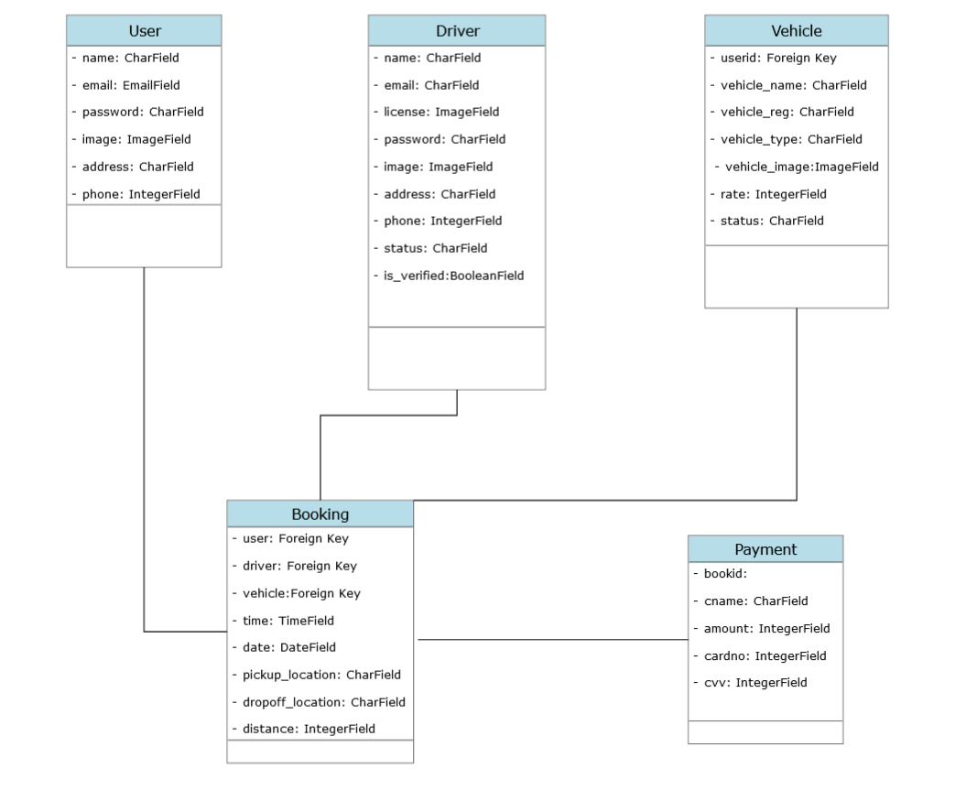
Project analysis slide 8
CLASS DIAGRAM

Slide 8
Project analysis slide 10
CHALLENGES FACED
The major challenge faced by me was to plan the process flow of the project.
While coming to the coding part I had difficulties in attractive user interface
To find the expense of a trip

Slide 9
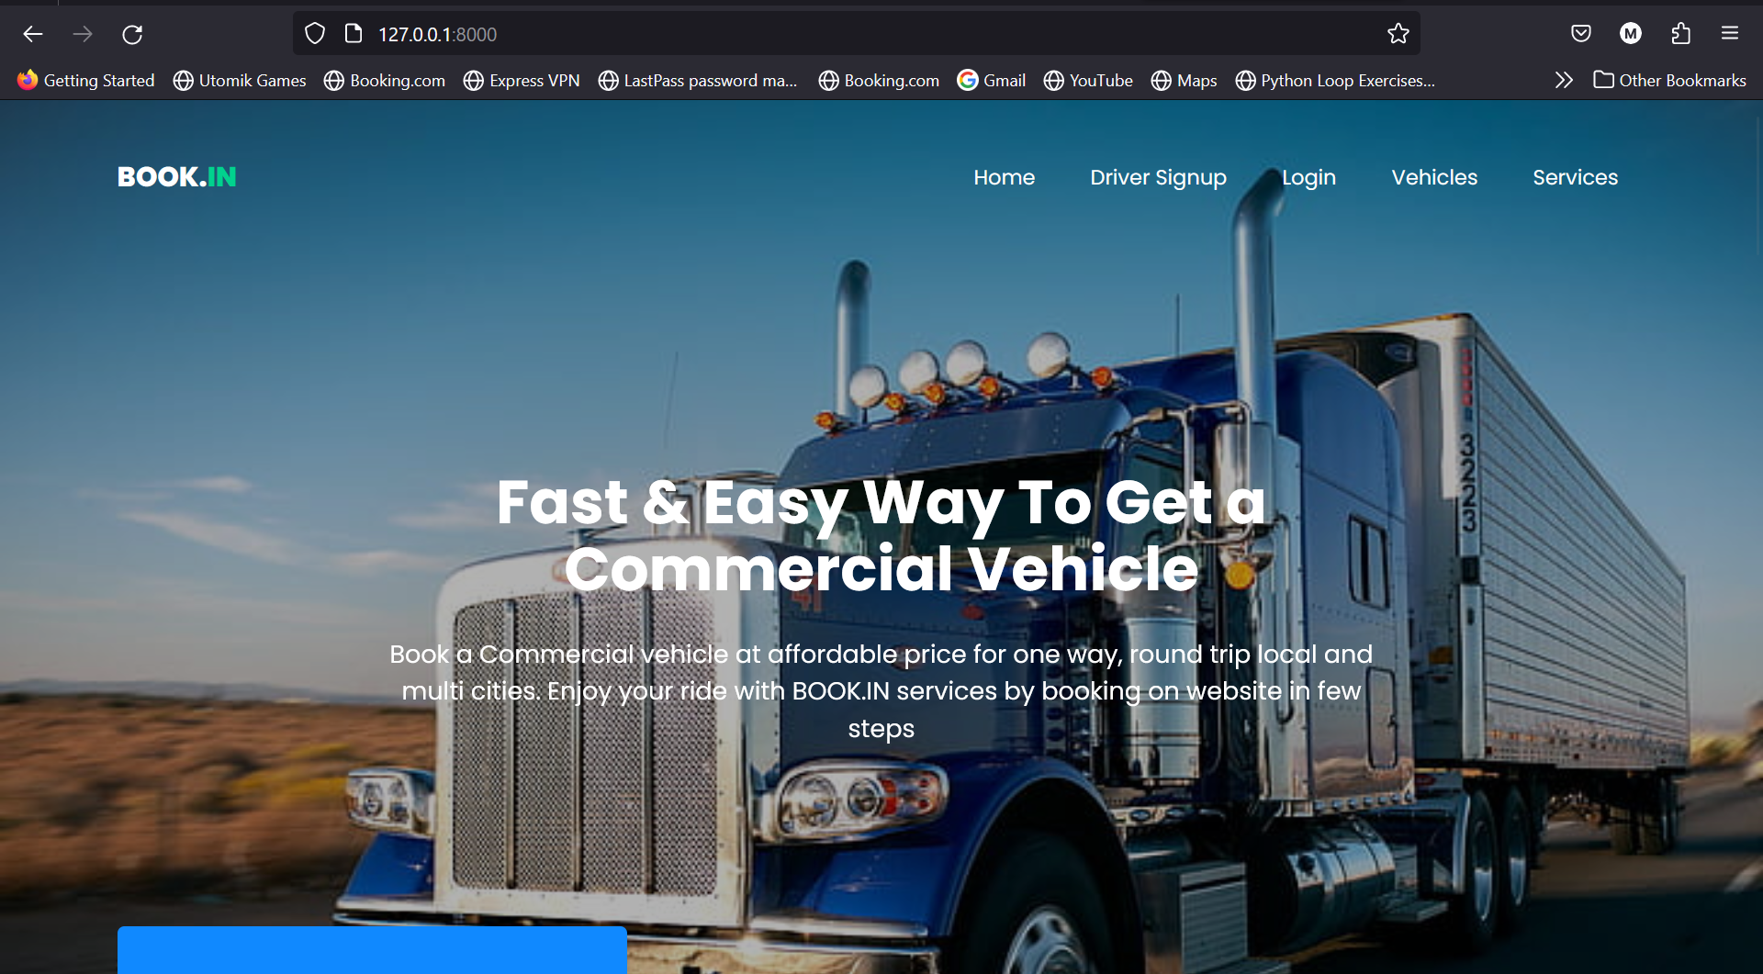
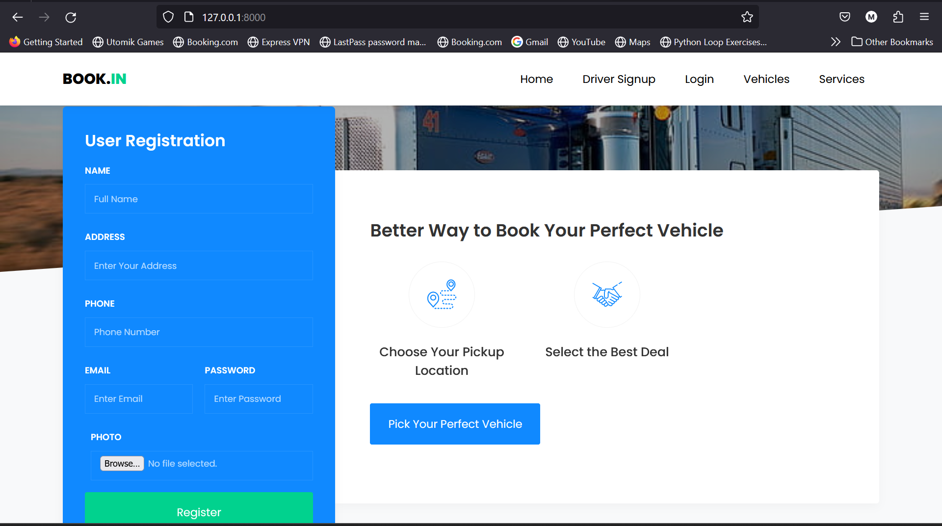
Project analysis slide 10
SCREENSHOTS

Slide 10
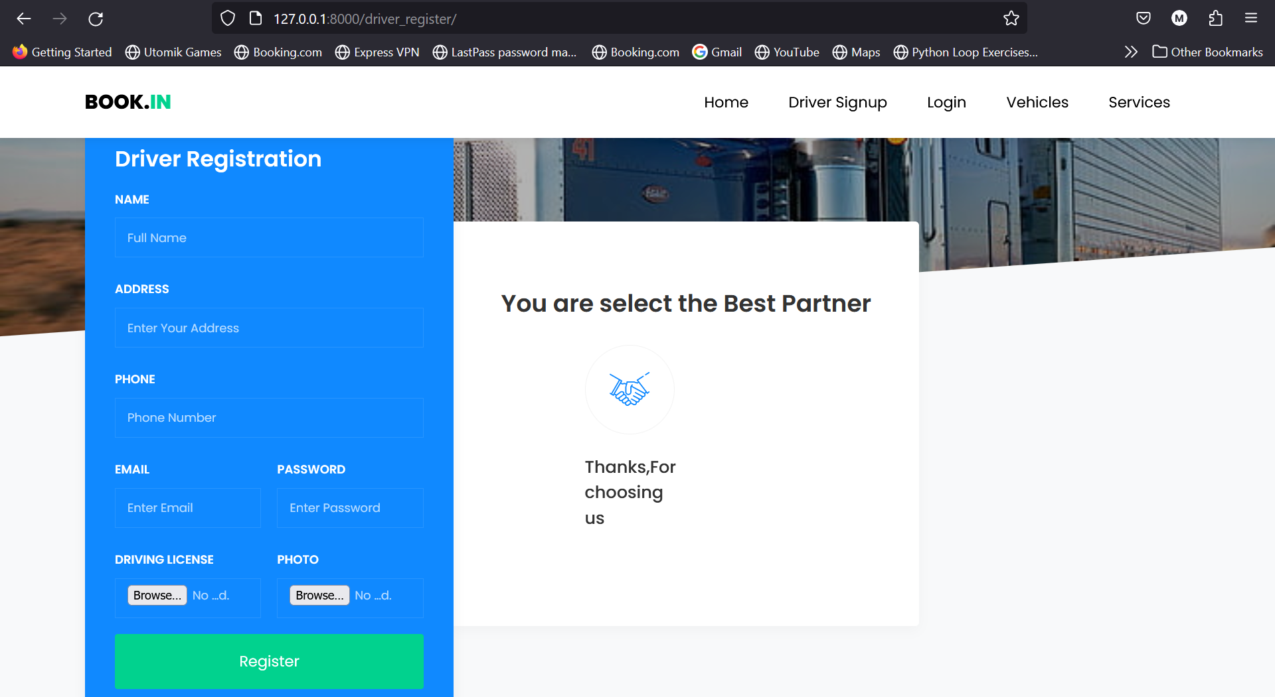
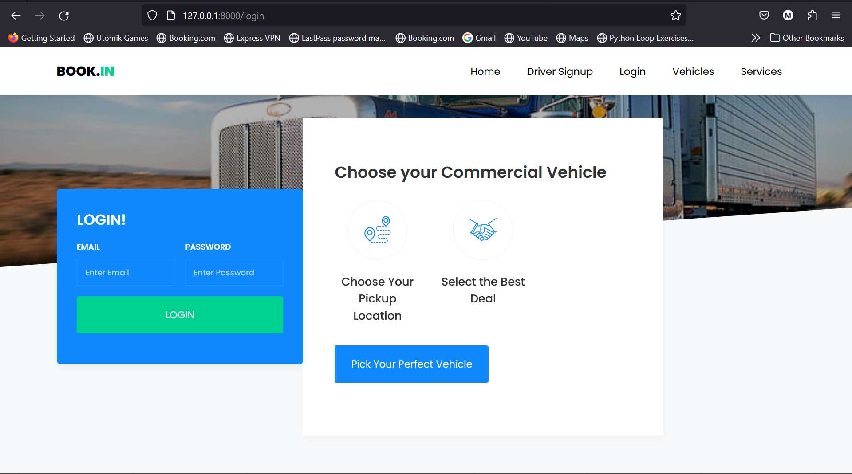
Project analysis slide 10
SCREENSHOTS

Slide 11
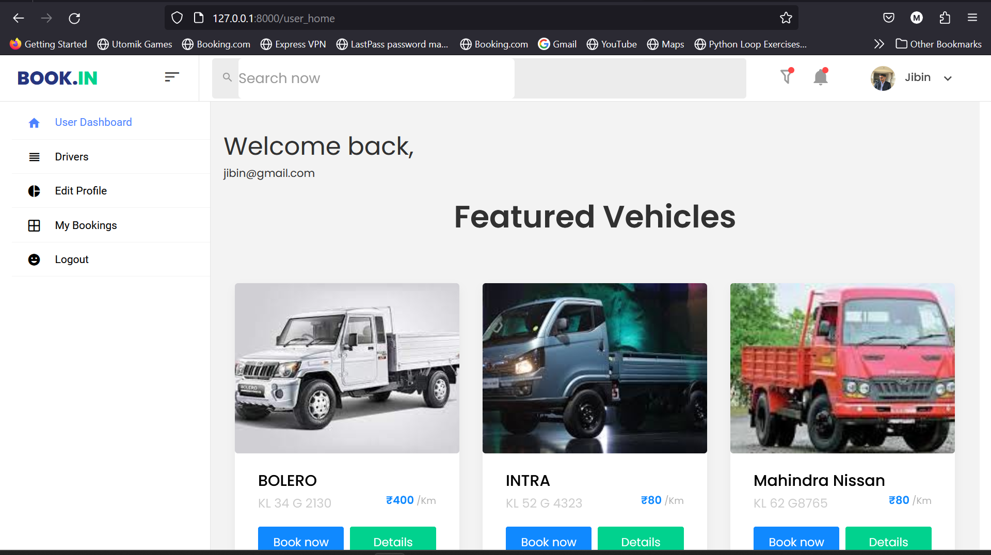
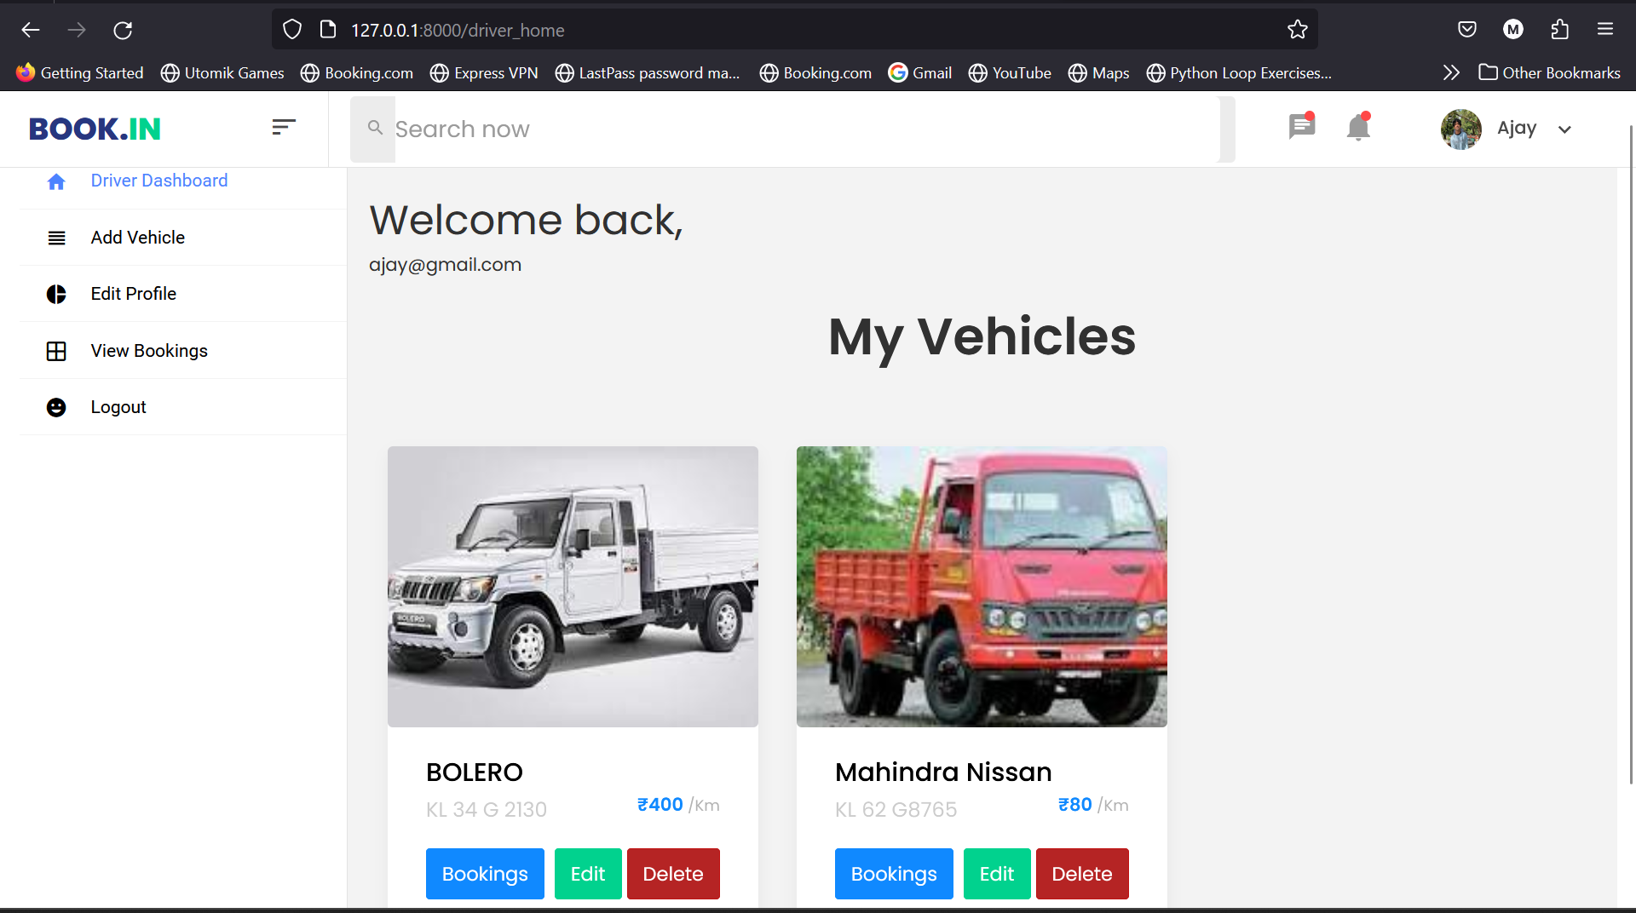
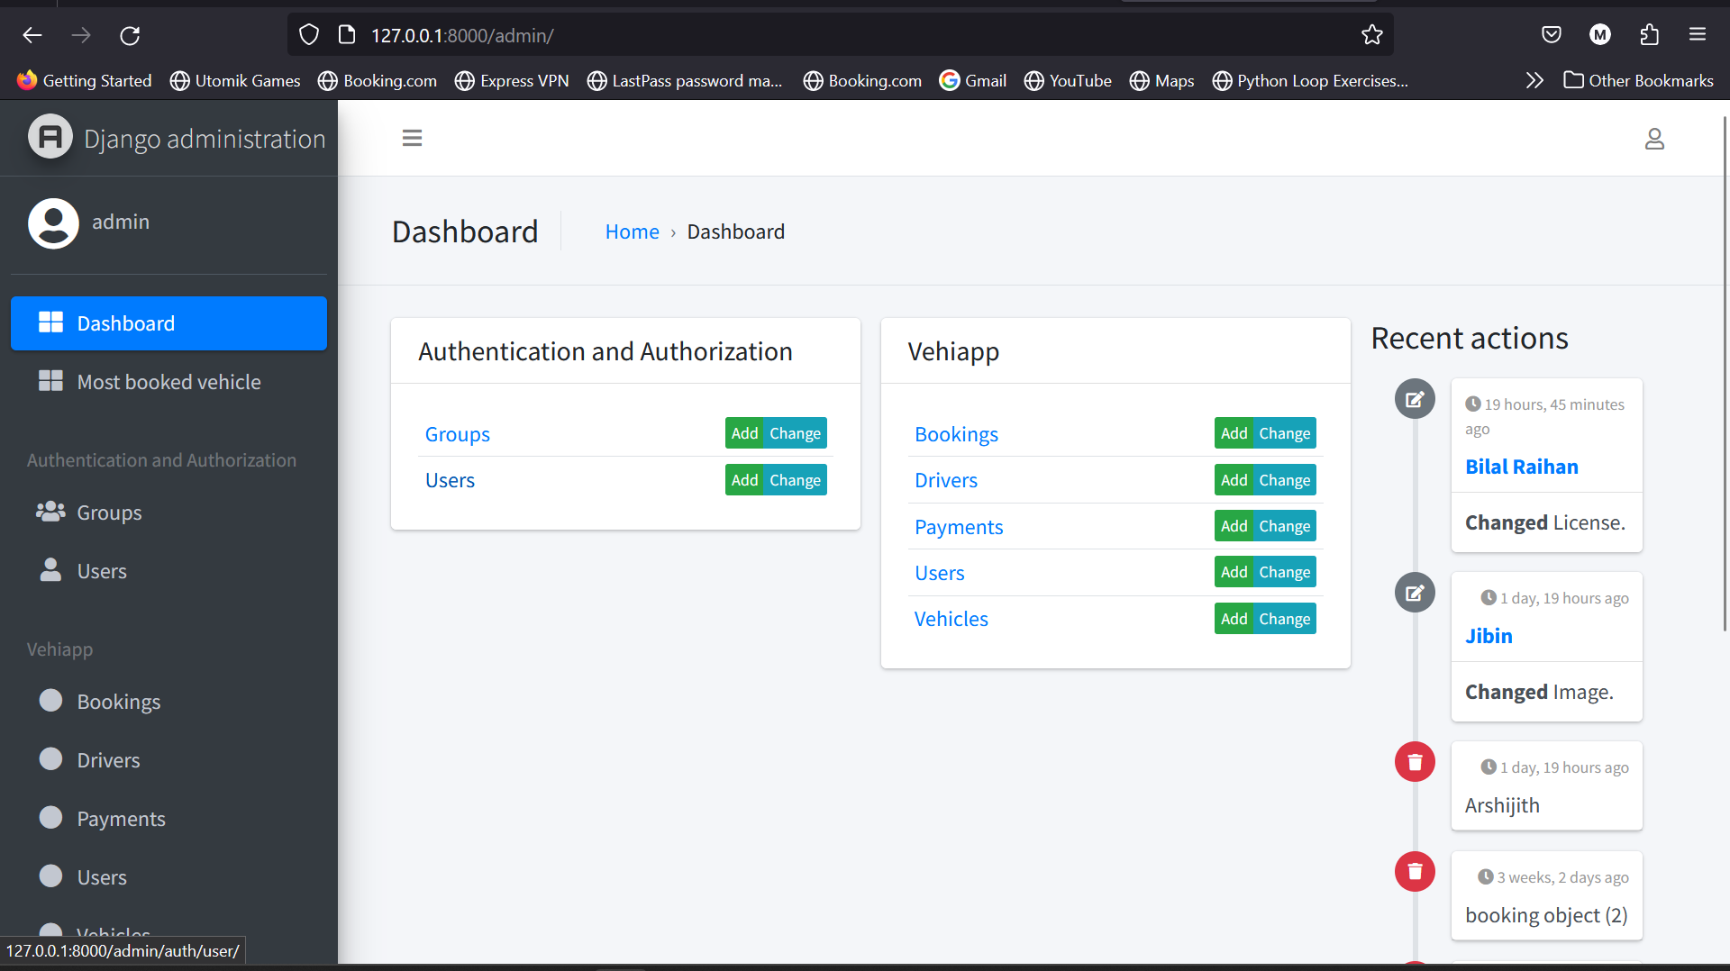
Project analysis slide 10
SCREENSHOTS

Slide 12
Project analysis slide 10
FUTURE ENHANCEMENT
Payment page: In the future, the Payment page will be a crucial component that enables users to securely and conveniently make payments for their commercial vehicle bookings, completing the seamless booking experience.
Live tracking: The user should be able to track the vehicles
Mobile application: Introduction of a mobile application can also be done so that this system becomes more user friendly

Slide 13
Project analysis slide 10
CONCLUSION
The commercial vehicle booking website focuses on enhancing the user experience by simplifying the process of booking commercial vehicles. With a user-friendly interface, it allows for easy navigation and quick access to the desired information. The website offers a comprehensive database of commercial vehicles, enabling users to search and filter based on their specific requirements. The booking system is efficient and secure, allowing users to reserve their chosen vehicle with minimal effort. Overall, the website aims to streamline the user experience, making commercial vehicle booking convenient and hassle-free.

Slide 14
Project analysis slide 10
REFERENCES
https://dev.to/thearjun/integrate-django-jazzmin-theme-to-django-admin-adminlte-dashboard-5aao
https://docs.djangoproject.com/en/4.2/
https://colorlib.com/wp/template/carbook/
https://www.bootstrapdash.com/product/majestic

Slide 15
Thank You
Presented by: Mohammed Bilal

